Slide 1
TEAM 10

Slide 2
Introduction
Dream Vidyut, a modern age Electricity Generation Company wants us to forecast the electricity demand for 5 corporate buildings.
Predicting electricity consumption can expand the scope in the following 4 major frontiers for an electricity generation company:
Energy Efficiency
User satisfaction
Demand-side management
Monthly Bill in check

Slide 3
Objectives
1
Create relevant features that have a significant effect on electricity demand
2
Train and test different models to get accurate predictions
3
Uncover unique insights about electricity demands

Slide 4
Model Approach
Baseline model created using MA
Stationarity tests
applied
ACF & PACF plots analysed
ARIMA
Data
Explanatory Analysis
Adding new features

Slide 5
Model Approach
Baseline model created using MA
Stationarity tests
applied
ACF & PACF plots analysed
ARIMA
Tree based models performed best
Checked multi- collinearity issues
(VCF)
Applied ensemble modelling voting regressor
Data
Explanatory Analysis
Adding new features
Immense correlation upto 14 days
Made final predictions

Slide 6
Model Approach
Baseline model created using MA
Stationarity tests
applied
ACF & PACF plots analysed
ARIMA
Tree based models performed best
Checked multi- collinearity issues
(VCF)
Applied ensemble modelling voting regressor
Data
Explanatory Analysis
Adding new features
Immense correlation upto 14 days
Made final predictions
LSTM & GRU Architecture applied

Slide 7
5 Buildings
Time Stamp
Building no.
Main meter
Submeter1
Submeter2
Data Description
26400
Records for each building
At a 15 min interval for 9 months

Slide 8
DATA
PRE-PROCESSING
Feature
Engineering
Feature Analysis
Feature Selection

Slide 9
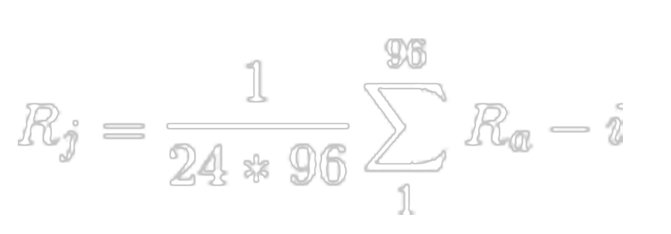

Feature Engineering
Data Preprocessing
Holidays
indicates sunday or public holiday
Lag 1
Lag 2
New Features
Weekday
one hot vector of 7 dimension
Model Training
Seasons
season in that month(Summer, Winter & Others)
Working Hours
if timestamp lies between 6am-7pm or not
Insights

Slide 10
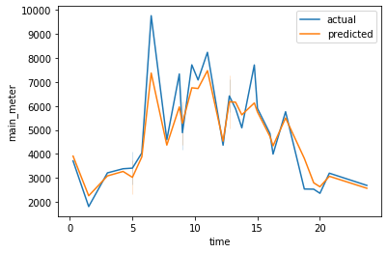
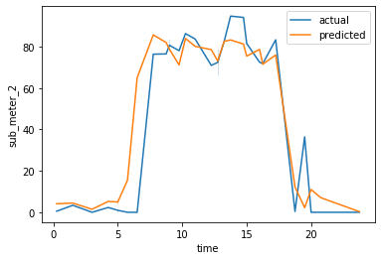
Feature Engineering
Data Preprocessing
Day
Fast Fourier
Transformation
(Indicates trend in meter values and helps in reduction
of noise)
New Features
Month
Model Training
Week
Insights

Slide 11
Feature Analysis
Data Preprocessing
Dickey-Fuller test:
Stationary
(P<0.1)
Checking Stationarity
Checked for better performance of regression models
KPSS test:
Non-
Stationary
(P>0.1)
Model Training
Sub meter 1 and Sub meter 2 appear to be skewed for some buildings
Data is difference stationary
(order of difference is 1)
Checking Skewness
Insights
Applied logarithmic,
Square root,Cube root transformation

Slide 12
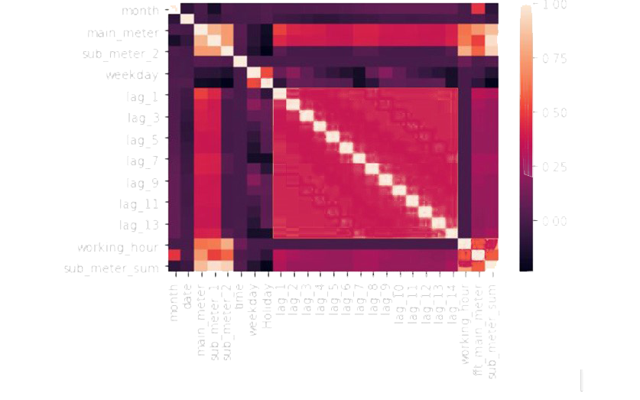
Feature Selection
Data Preprocessing
Correlation matrix and heat maps were used to find the significant features.
Model Training
Continuous Variables
Insights

Slide 13
Feature Selection
Data Preprocessing
P-values of ANOVA test for weekdays
ANOVA test for weekdays as it is a multicategorical variable.
Building 1 | P value
Main meter | 3.24e-20
Sub meter 1 | 1.8e-80
Sub meter 2 | 0.0
Model Training
Categorical Variables
Two sample T-test was done for the features holiday and working hours.
Building 1 | Holiday | Working hour
Main meter | 0.0 | 0.0
Sub meter 1 | 4.19e-113 | 0.0
Sub meter 2 | 0.0 | 0.0
Insights
P-values of T-test

Slide 14
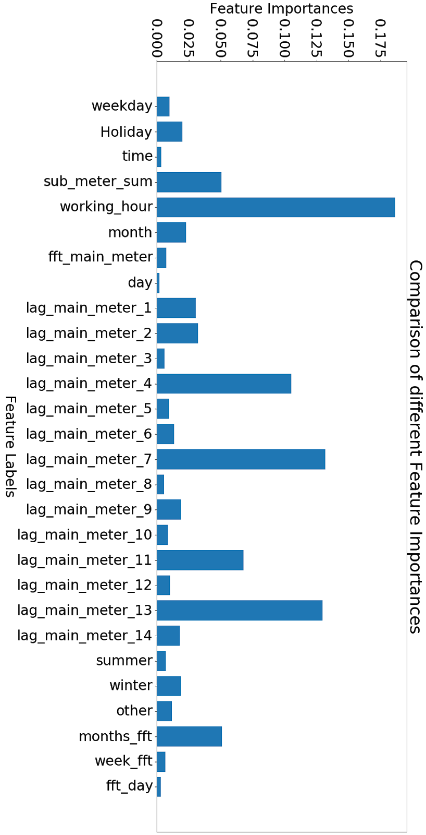
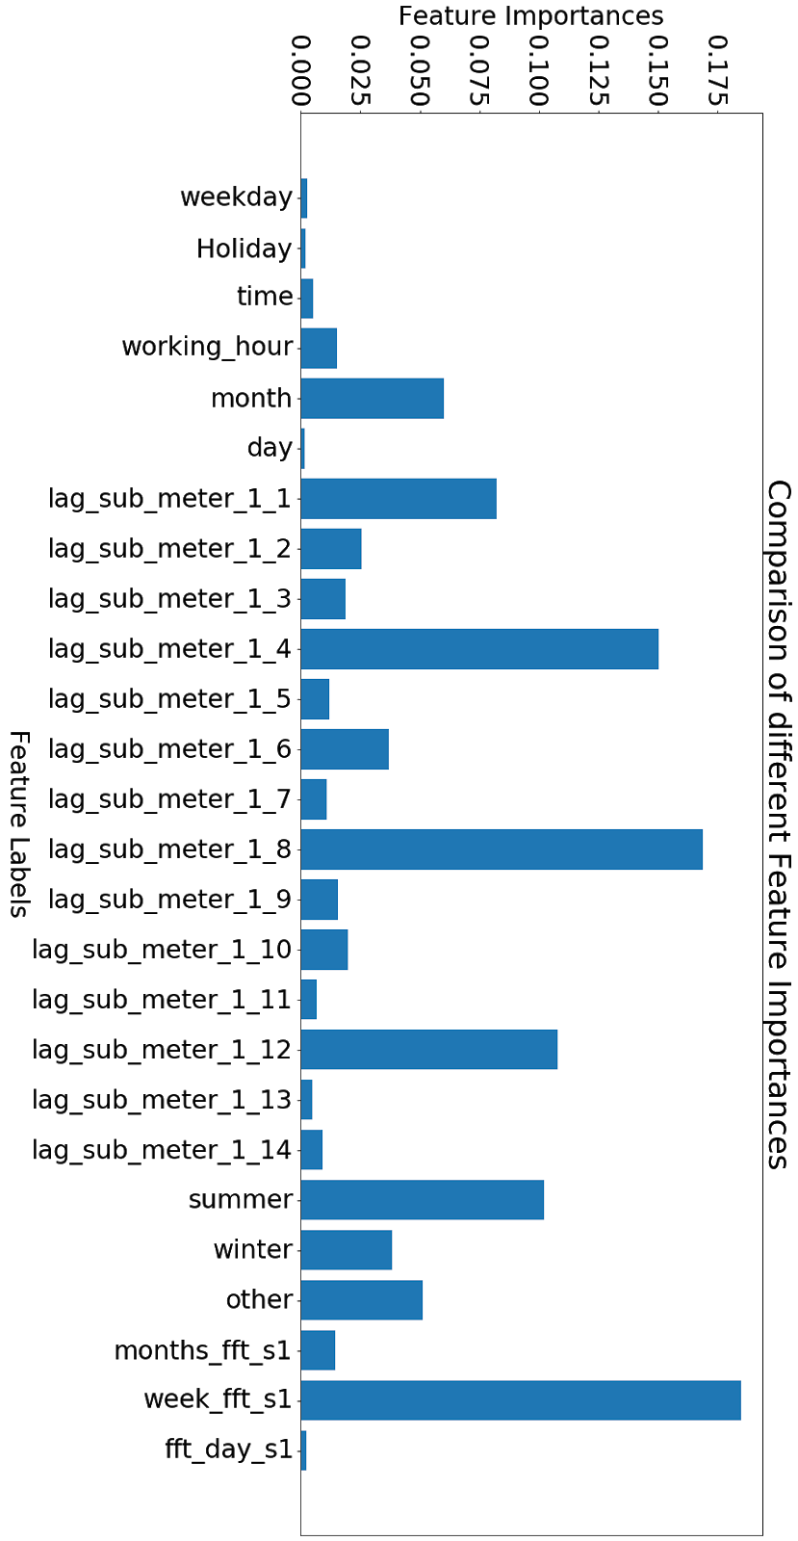
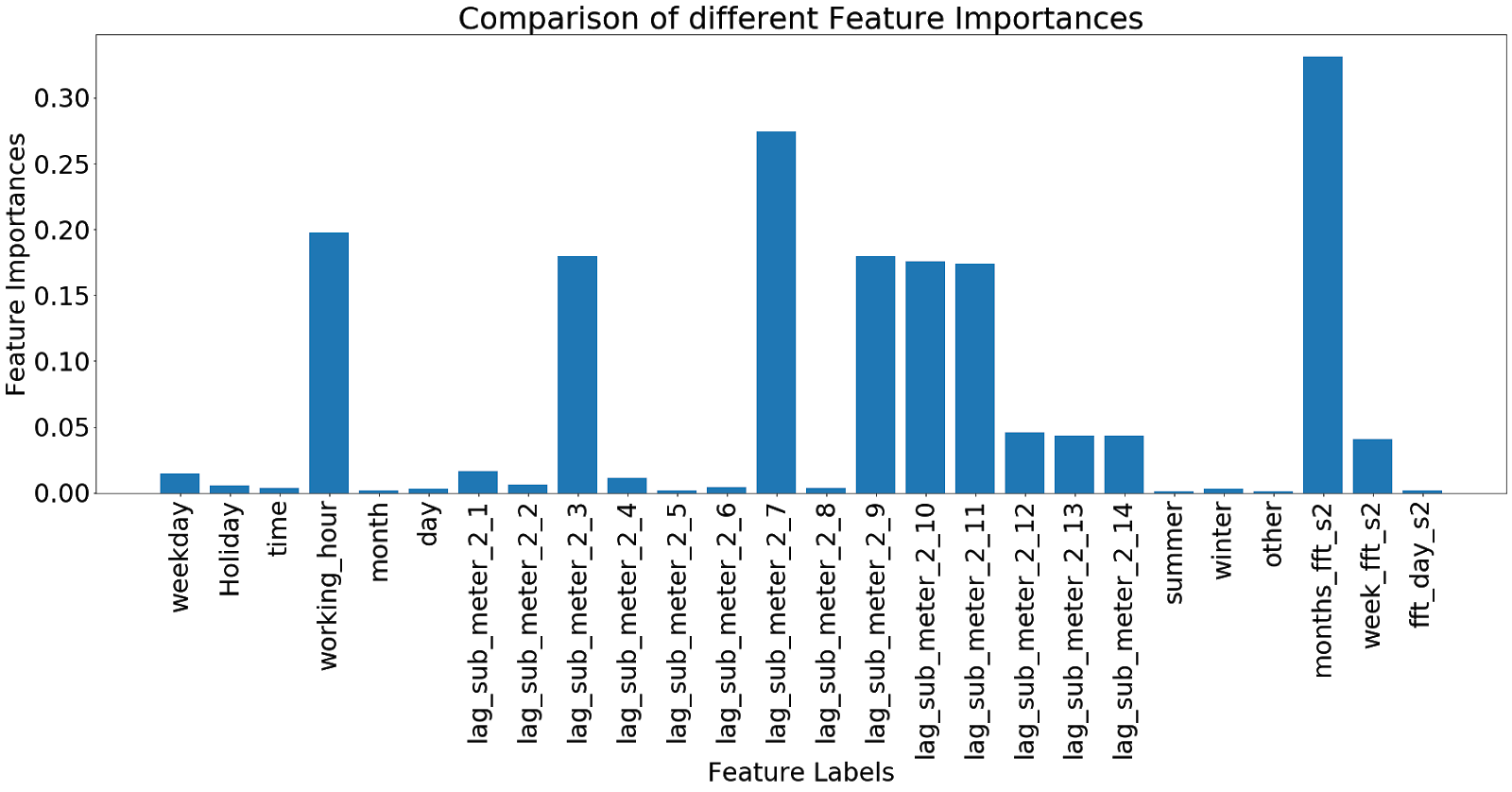
Feature Selection
Data Preprocessing
Extra Tree Regressor was used to assess the feature importance of both categorical and continuous variables.
For Categorical and Continuous
Model Training
Insights
Main meter
Sub meter 1
Sub meter 2

Slide 15
ARIMA
MODELS TRAINED

Slide 16
ARIMA
Lasso Regression
Ridge
Regression
Gradient Boosting
Regressor
Cat Boost
Regressor
Random forest Regressor
Elastic net Regression
Support vector Regression
XGBoost
Regressor
LSTM
MODELS TRAINED

Slide 17
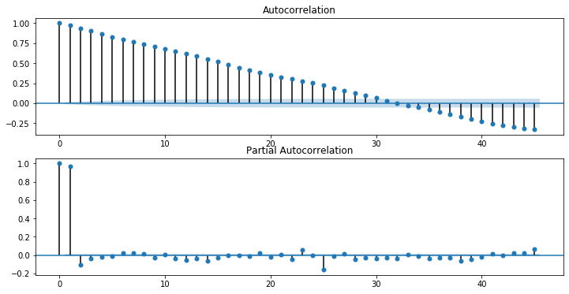
We initially created baseline models using Persistence Algorithm, Moving average and ARIMA.
Data Preprocessing
For proper values of p, d, q parameters of the ARIMA model we analysed the ACF and PACF plots which helped us to conclude that for the ARIMA model (2,1,0) is the most optimal for all the buildings and all the meter readings.
Baseline Models
Model Training
Autocorrelation
Partial Autocorrelation
Insights
‹#›

Slide 18
Data Preprocessing
We applied several regression models among which Gradient Boosting, Random Forest and Xgboost gave very good results.
The following models were tested:
· Lasso Regression
· Ridge Regression
· Random forest Regression
· Elastic net regression
· Support vector regression
· XGBoost regressor
· Gradient Boosting
· Catboost Regressor
Regression Models
Model Training
As we are using lagged values as a feature there could be an issue of multicollinearity. So, we checked for multicollinearity between the variables using VIF (Variance Inflation Factor). We found that the VIF values for all buildings except 4 was coming out to be less than 10. So, lag values were used for the rest of the buildings only.
Insights
‹#›

Slide 19
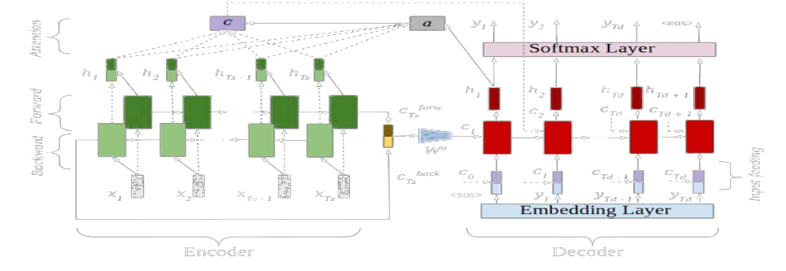
The 25-dimensional vector is the input which encodes and outputs an encoded state. In the decoder phase we provide the 24-dimensional vector (all features except electricity consumption) as input. So, we provide the features for 14 days in the encoder phase and forecast the electricity consumption for next day keeping sufficient stride between 2 series of inputs.
Model 1 We created vectors for different time-stamps and then passed through an Encoder-Decoder Long Short-Term Memory with Attention Layer.
Data Preprocessing
LSTM
Model Training
Model 2
The model used has 5 layers. There are 2 LSTM layers followed by two Dense layers with relu activation function and another Dense layer with linear activation. The adam optimizer was used while compiling the model.
Insights
‹#›

Slide 20
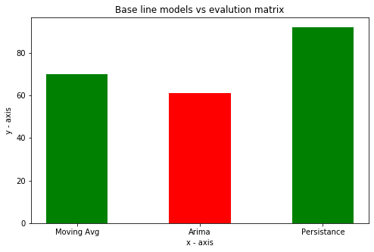
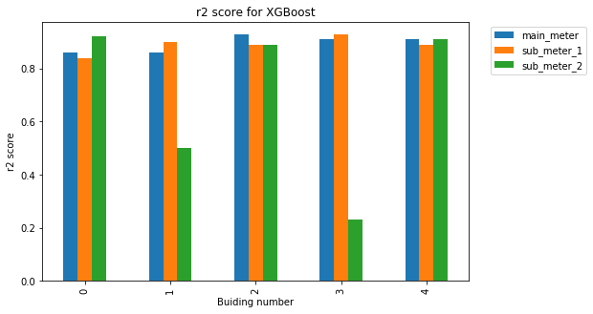
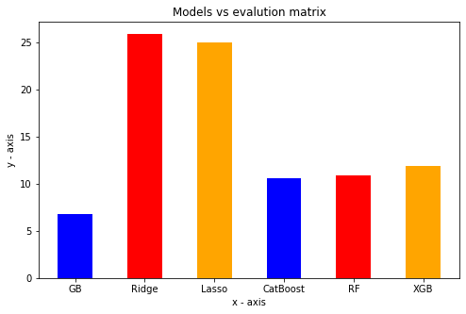
Results
Model | Evaluation metric |  | R2 score (building 1)
 |  | Mainmeter | sub_meter_1 | sub_meter_2
Gradient Boosting | 3.68 | 0.86 | 0.84 | 0.92
XGBoost | 9.7 | 0.86 | 0.90 | 0.91
Random forest | 10.05 | 0.87 | 0.91 | 0.86
Model | Evaluation metric |  | RMSE (building 1)
 |  | Mainmeter | sub_meter_1 | sub_meter_2
LSTM | 16.64 | 3281 | 258 | 125.324

Slide 21
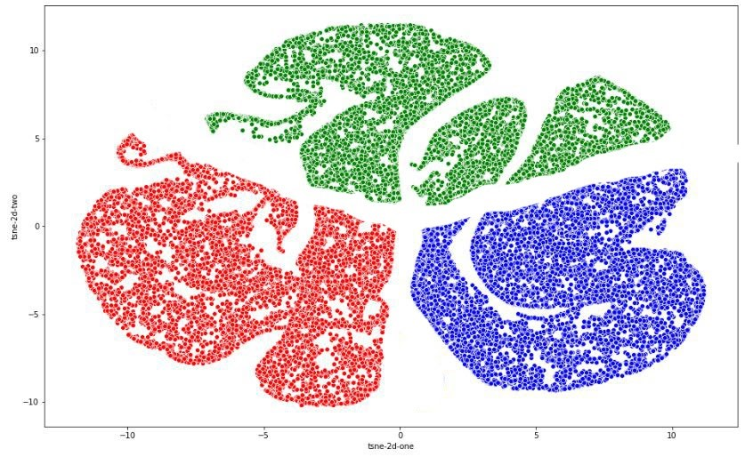

Clustering
Data Preprocessing
We clustered the entire data into 3 clusters to identify the discrete months, day of the week and date of the month belonging to homogeneous groups.We try to visualize it using t-SNE plots. Points in Cluster-1(Red) have the highest electricity consumption. Cluster-2 (Blue) has medium electricity consumption whereas Cluster-3(Green) has the lowest electricity consumption of all.
Model Training
Silhouette Score : 0.61
Insights

Slide 22
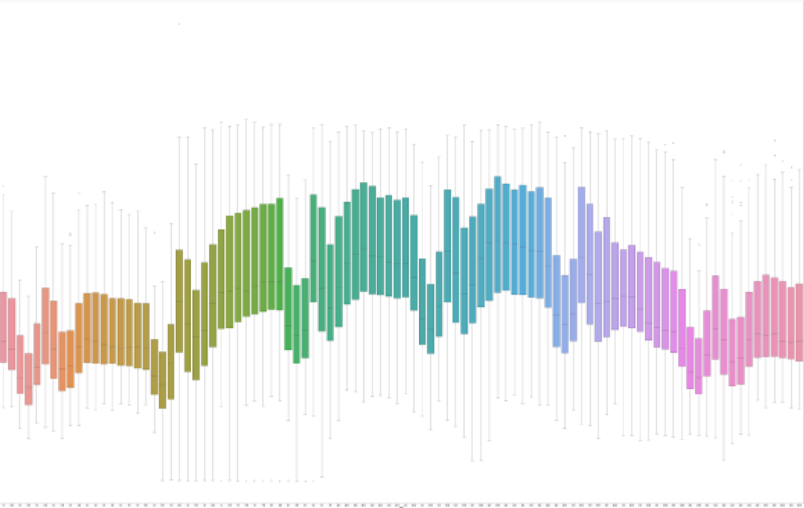
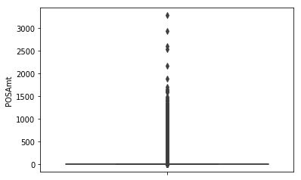
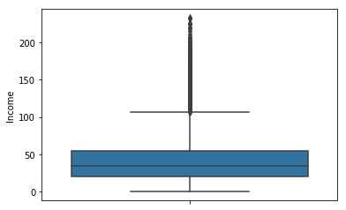
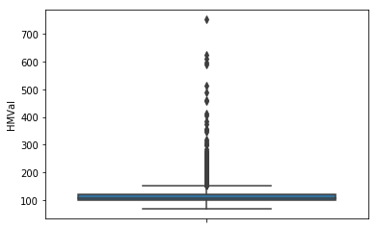
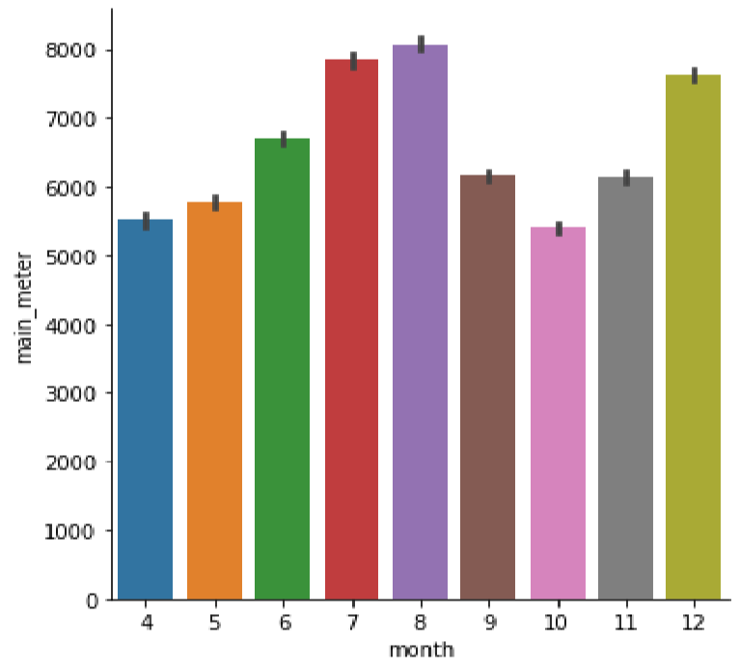
Outliers Detection
Insights
For all buildings except 4, Submeter 1 readings show a local minima after every 4 hours. This drop lasts for 30 minutes. This indicates that there might be workplace breaks every 4 hours in 30-minute slots.
We detected outliers using Box-Plots and Isolation Forest and the rows showing significant deviation were removed.
In Building 4, the pattern is seen in Submeter 2 and not Submeter 1 and this could be attributed to an exchange in the appliances these meters measure.
Main meter readings are quite high. However, the main-meter readings were found to be less for the months of April, September and October. Even for the month of May, the main-meter reading was not as high as expected given the it is summer during that time.

Slide 23
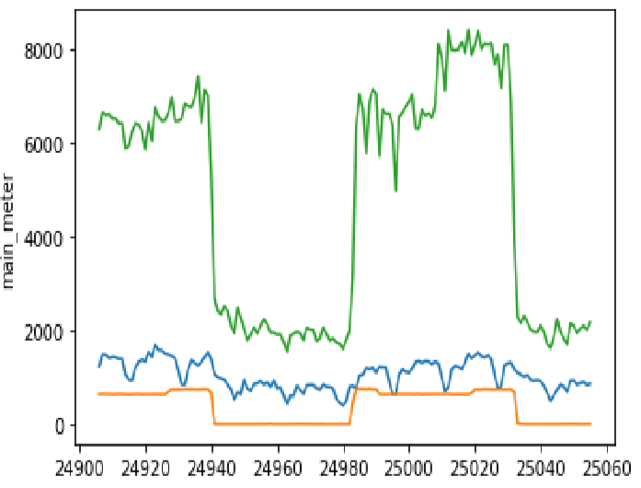
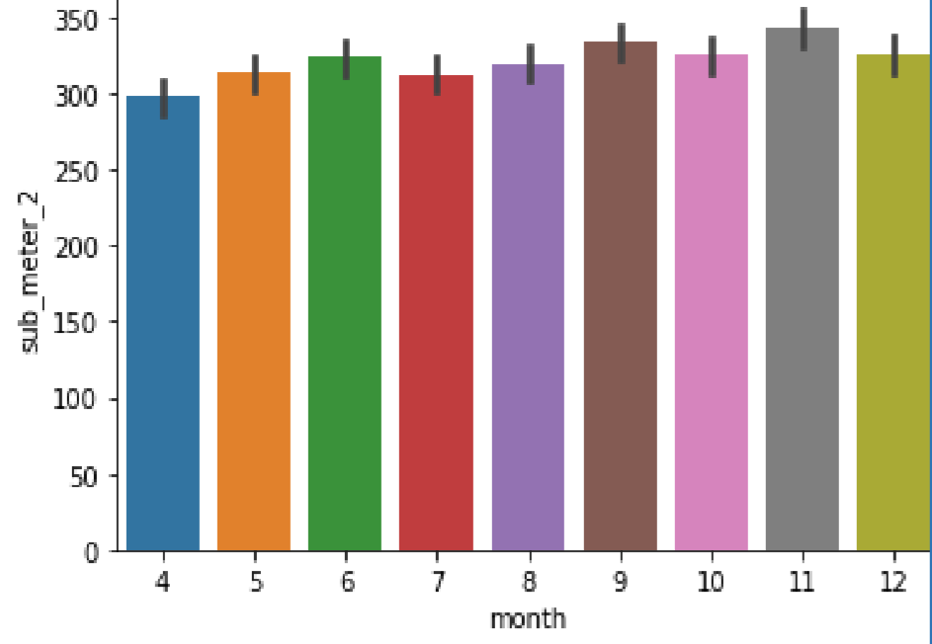
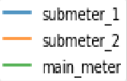
Outliers Detection
Insights
Submeter 2 readings are significantly lower than the main meter and Submeter 1 readings. A possible explanation for this is that the submeter 2 is used to monitor energy usage for individual departments.
For all buildings except 4, Submeter 1 readings show a local minima after every 4 hours. This drop lasts for 30 minutes. This indicates that there might be workplace breaks every 4 hours in 30-minute slots.
We detected outliers using Box-Plots and Isolation Forest and the rows showing significant deviation were removed.
In Building 4, the pattern is seen in Submeter 2 and not Submeter 1 and this could be attributed to an exchange in the appliances these meters measure.
Main meter readings are quite high. However, the main-meter readings were found to be less for the months of April, September and October. Even for the month of May, the main-meter reading was not as high as expected given the it is summer during that time.
Also, the sub-meter 2 reading was found to be nearly constant for all the months across all the buildings.

Slide 24
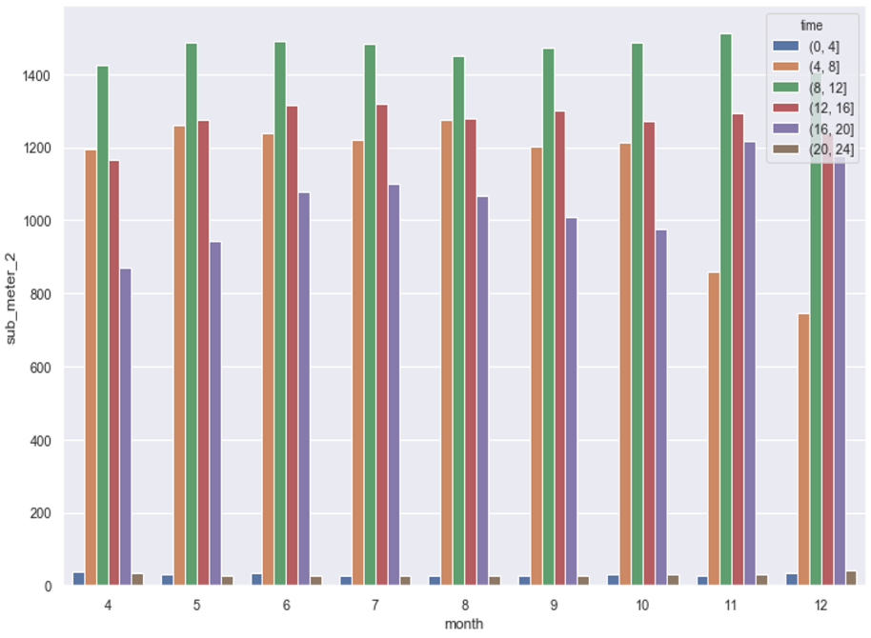
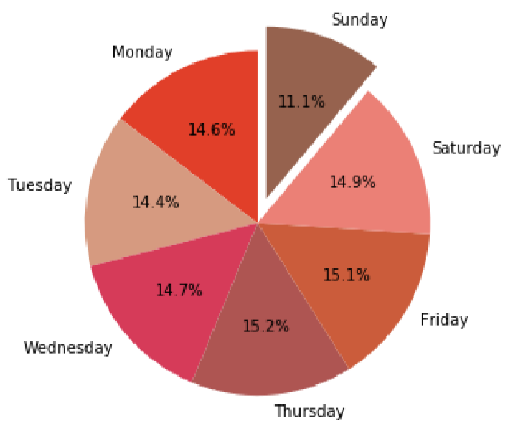
The electricity consumption has a noticeable dip on Sundays. This implies that Sunday is a day off for most employees of these corporate buildings, but Saturday isn’t.
In all buildings except Building 4, the Submeter 2 readings are significantly low during non-working hours and show a sudden increase few hours before and after the working hr (6AM to 7PM). This implies submeter 2 measures an appliance or department that is switched on a few hours prior to the arrival of employees in the morning and is switched off a few hours after the departure of the employees after work.

Slide 25
Thanks!

